Slide 1

Comparing Association and Causality between Risks Factors and Heart Disease
By: Tziporah Horowitz
Notes:
Hi everyone!
My name is Tziporah Horowitz and my project is a comparative analysis between associative and causal classifications models in the context of predicting heart disease.

Slide 2
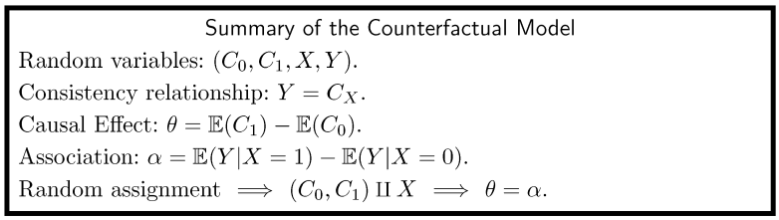
The Counterfactual Model (Wasserman 255)
Notes:
So, before I get into the analysis, I’m just going to give a brief overview of counterfactual models.
I’m not going to go into it so much because we covered it in class, but if you’re interested in learning more it’s chapter 16 in the Wasserman textbook.

Slide 3
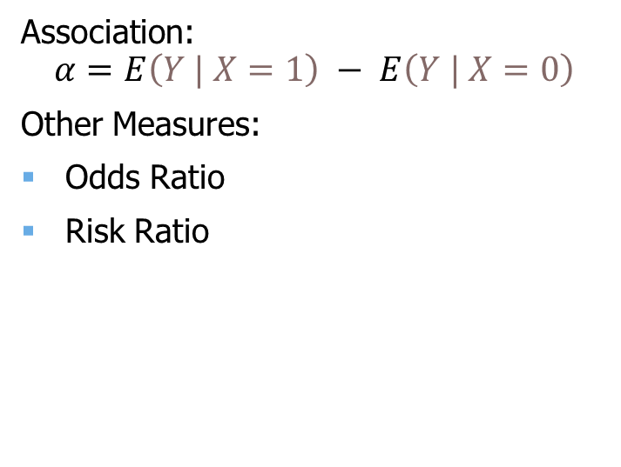
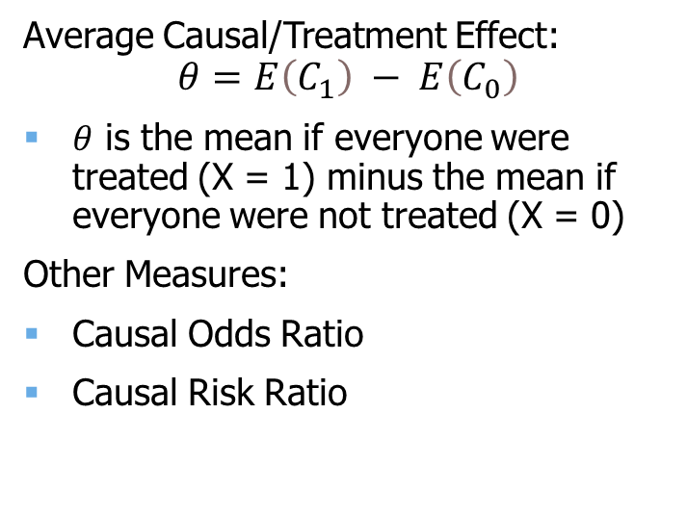
Causation vs Association
Average Causal/Treatment Effect:
$$θ=E\left(C_{1}\right) − E\left(C_{0}\right)$$
$θ$ is the mean if everyone were treated (X = 1) minus the mean if everyone were not treated (X = 0)
Other Measures:
Causal Odds Ratio
Causal Risk Ratio
Association:
$$α=E\left(Y | X=1\right) − E\left(Y | X=0\right)$$
Other Measures:
Odds Ratio
Risk Ratio
Causation
Association

Slide 4
Methods
Logistic Regression
Parametric model that measures association via odds ratio.
Random Forests
Ensemble tree-based model that measures association by training on different permutations of the feature set.
BART (Bayesian Additive Regression Trees)
Non-parametric Bayesian model that uses a sum-of-trees approach and a regularization prior to approximate the function f(x) = E [Y | x] via Bayesian backfitting MCMC.
Hill proposed using BART to estimate the average treatment effect in non-experimental settings due to its inherent calculation of f(x). [Hill, J. L. (2011)]
Notes:
A lot of times we want to know causality, but causality can only really be measured under randomized control trials.
And a lot of times in the real world we don’t have that, so we’re forced to look at association.
For my analysis I looked at 3 classification models, 2 of which can be used to understand the association between risk factors and a binary classifier, while the other can be used to understand causation.

Slide 5
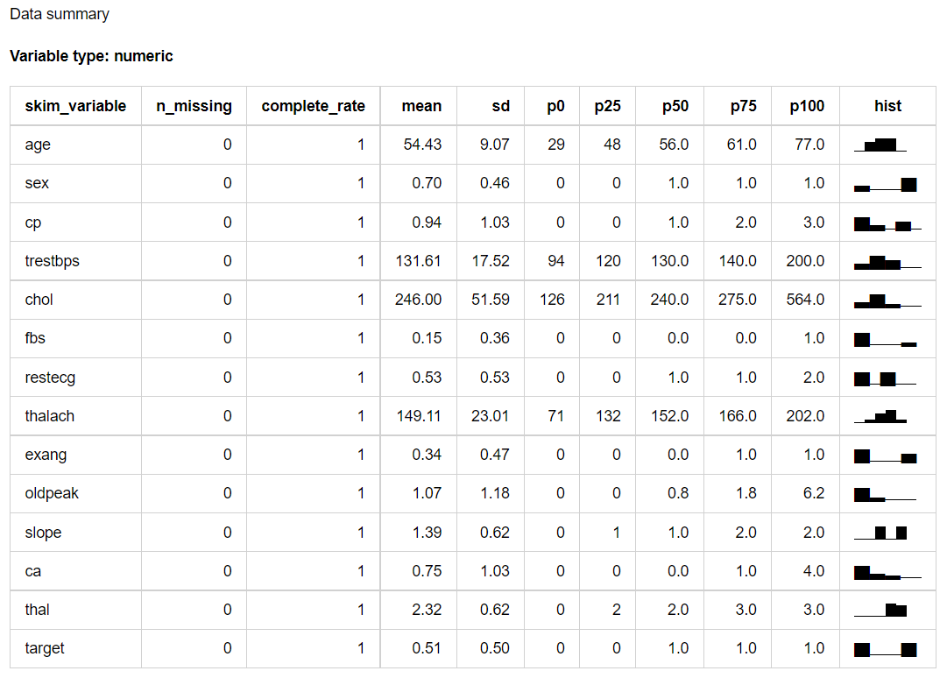
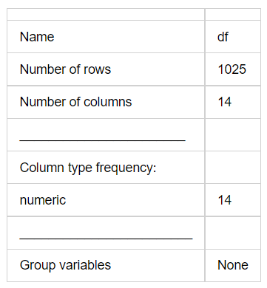
Heart Disease Dataset

Slide 6
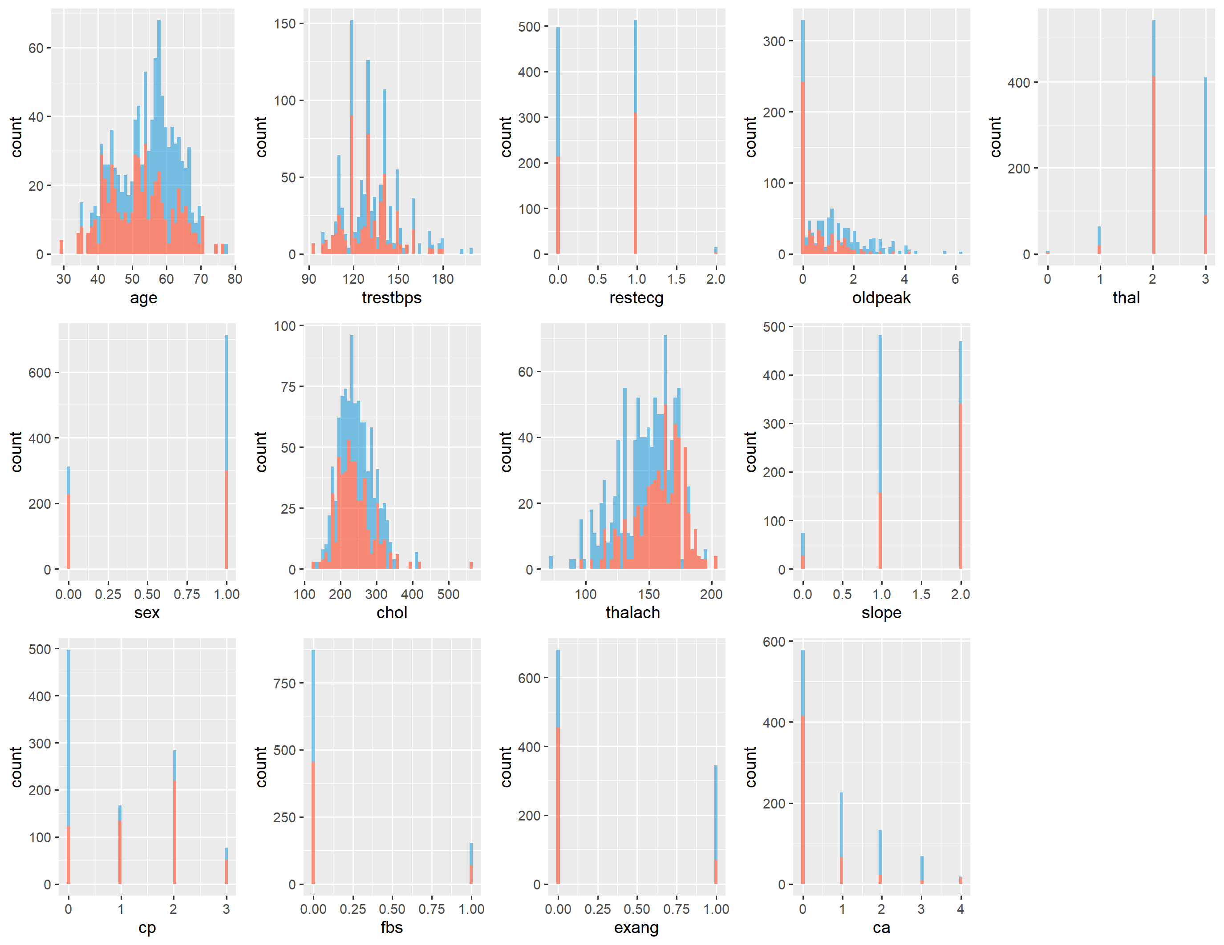
Blue = 0
Red = 1
Notes:
Here you can see the histograms of the risk factors when compared to the target.
The blue historgrams are patients who did not contract heart disease and the red histograms are patients that did.

Slide 7
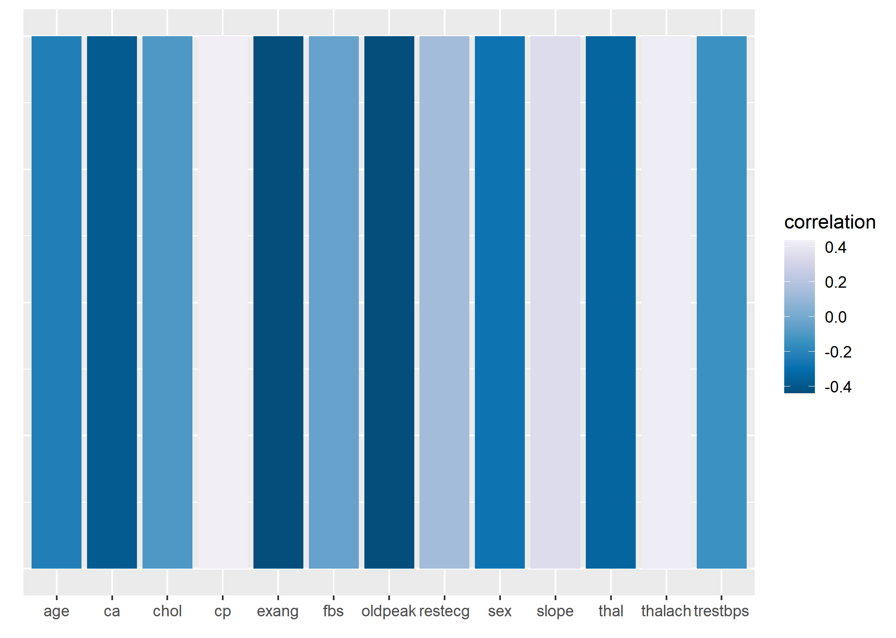
Notes:
ca – blood vessels colored by fluoroscopy
cp – chest pain
exang – exercise induced angina

Slide 8
Logistic Regression
 | Estimate | Odds Ratio | Std..Error | z.value | Pr...z..
(Intercept) | -0.64141 | 0.5265499 | 2.510612 | -0.25548 | 0.798353
age | 0.022203 | 1.0224512 | 0.018604 | 1.193454 | 0.232692
sex | -1.74857 | 0.1740235 | 0.397958 | -4.39384 | 1.11E-05 | ***
resting blood pressure | -0.01984 | 0.9803555 | 0.00855 | -2.32055 | 0.020311 | *
serum cholesterol | -0.00526 | 0.9947538 | 0.002888 | -1.82103 | 0.068602 | .
fasting blood sugar > 120 mg/dl | 0.296628 | 1.3453154 | 0.409241 | 0.724825 | 0.468559
maximum heart rate achieved | 0.022726 | 1.0229864 | 0.009033 | 2.515982 | 0.01187 | *
exercise induced angina | -0.79549 | 0.4513584 | 0.329639 | -2.41323 | 0.015812 | *
oldpeak | -0.34802 | 0.7060858 | 0.180994 | -1.92282 | 0.054503 | .
chest pain = 1 | 0.961956 | 2.6168104 | 0.395997 | 2.429199 | 0.015132 | *
chest pain = 2 | 2.028971 | 7.6062587 | 0.36538 | 5.553045 | 2.81E-08 | ***
chest pain = 3 | 2.558827 | 12.920656 | 0.579411 | 4.416254 | 1.00E-05 | ***
resting electrocardiograph = 1 | 0.150976 | 1.1629688 | 0.281241 | 0.536822 | 0.591391
resting electrocardiograph = 2 | -1.16097 | 0.3131812 | 2.173118 | -0.53424 | 0.593173
slope = 1 | -0.61958 | 0.5381692 | 0.567822 | -1.09116 | 0.275204
slope = 2 | 0.673433 | 1.9609582 | 0.601172 | 1.120201 | 0.262628
major vessels colored = 1 | -2.44333 | 0.0868715 | 0.359945 | -6.78805 | 1.14E-11 | ***
major vessels colored = 2 | -3.2715 | 0.0379494 | 0.566718 | -5.77271 | 7.80E-09 | ***
major vessels colored = 3 | -2.24503 | 0.1059246 | 0.810761 | -2.76904 | 0.005622 | **
major vessels colored = 4 | 1.022481 | 2.7800848 | 1.355826 | 0.754139 | 0.450766
thalassemia = 1 | 2.244612 | 9.4367565 | 1.744049 | 1.287012 | 0.19809
thalassemia = 2 | 2.269069 | 9.6703935 | 1.682617 | 1.348535 | 0.177486
thalassemia = 3 | 0.811895 | 2.2521726 | 1.682796 | 0.482468 | 0.629473
Notes:
Very interoperable, looks like a regular regression output.
Odds ratio’s were calculated by exponentiating the regression coefficients.
Odds ratios that are close to 1 indicate no association between exposure and contracting the disease, and odds ratios that are far from 1 indicate that there is an association between the variables.

Slide 9
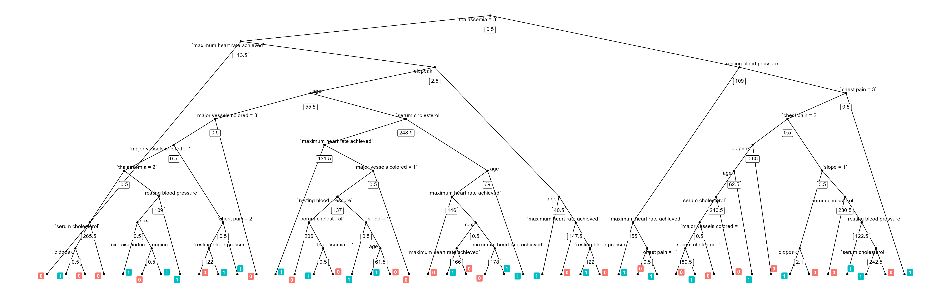
Random Forests

Slide 10
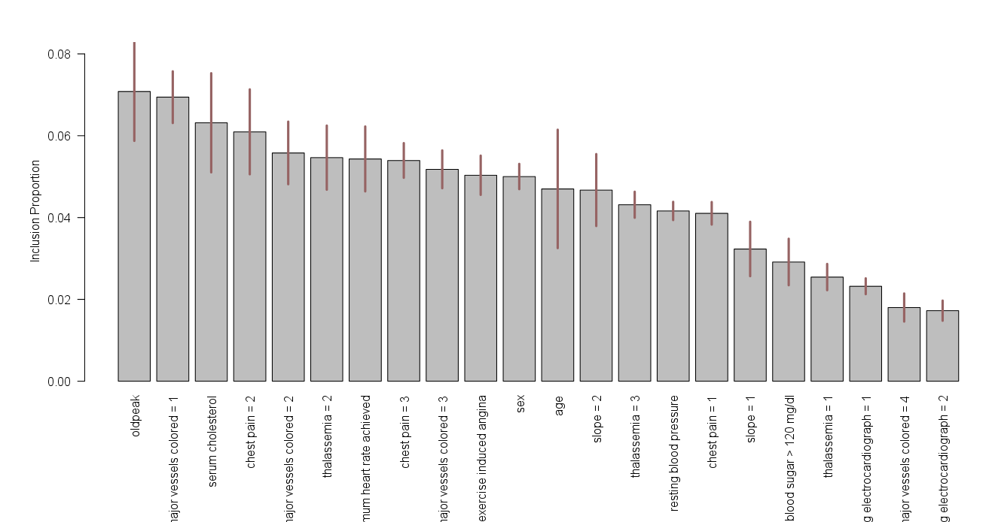
BART

Slide 11
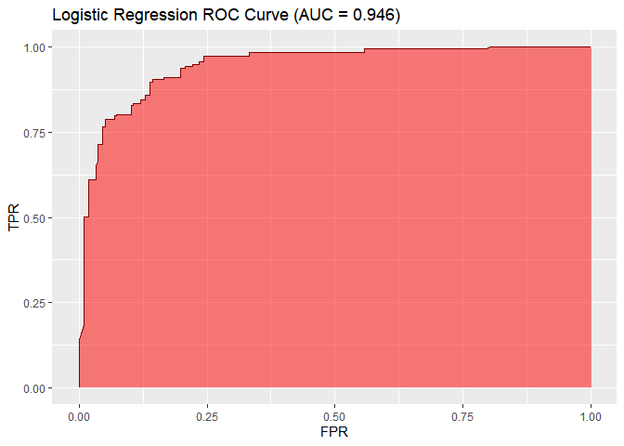
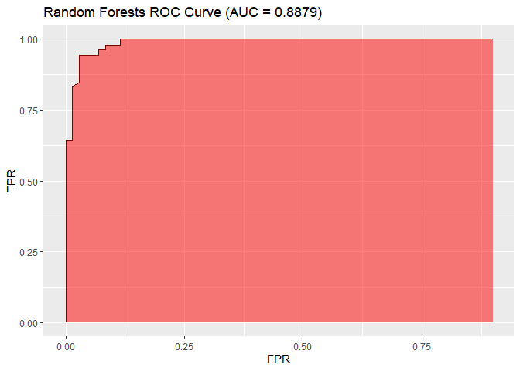
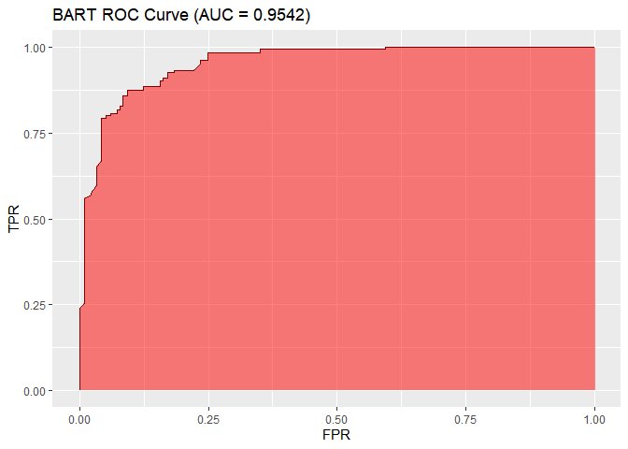
Scoring

Slide 12
Code
https://github.com/TzipHoro/ACM726-CausalInference/tree/master

